Slide 1
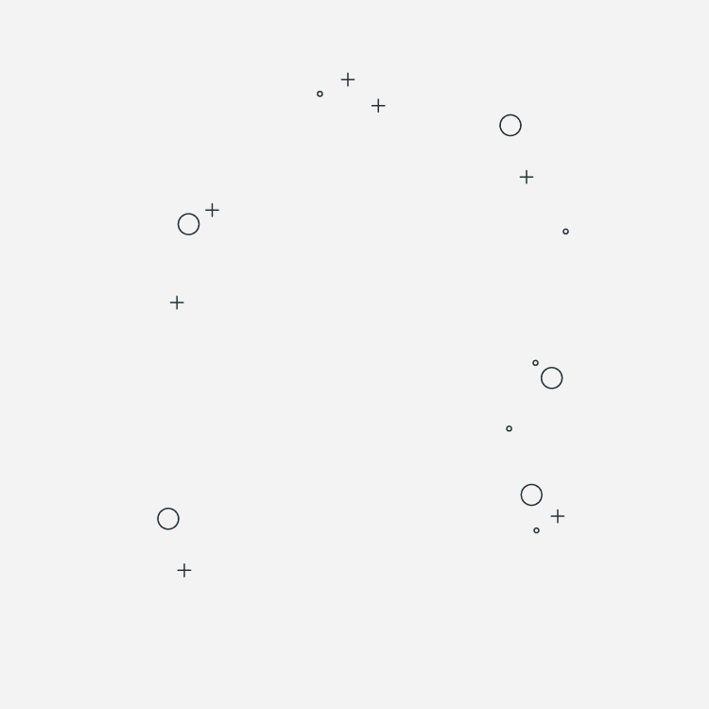

CHESS Pieces
Classifier
course Instructor:-
Dr. Jignesh Bhatt
Teaching Assistant:-
Swati Rai
Team Members:
201951065: Manthan Ghasadiya
201951074: Rushi Javiya
201952224: Mohit Panchasara
201952231: Tapan Savani

Slide 2
INTRODUCTION
This project is based on chess pieces classification using deep learning.
It is based on multi-class classification for chess pieces using “Convolutional Neural Networks”.
A Convolutional Neural Network (ConvNet/CNN) is a Deep Learning algorithm which can take in an input image, assign importance (learnable weights and biases) to various aspects/objects in the image and be able to differentiate one from the other class.

Slide 3
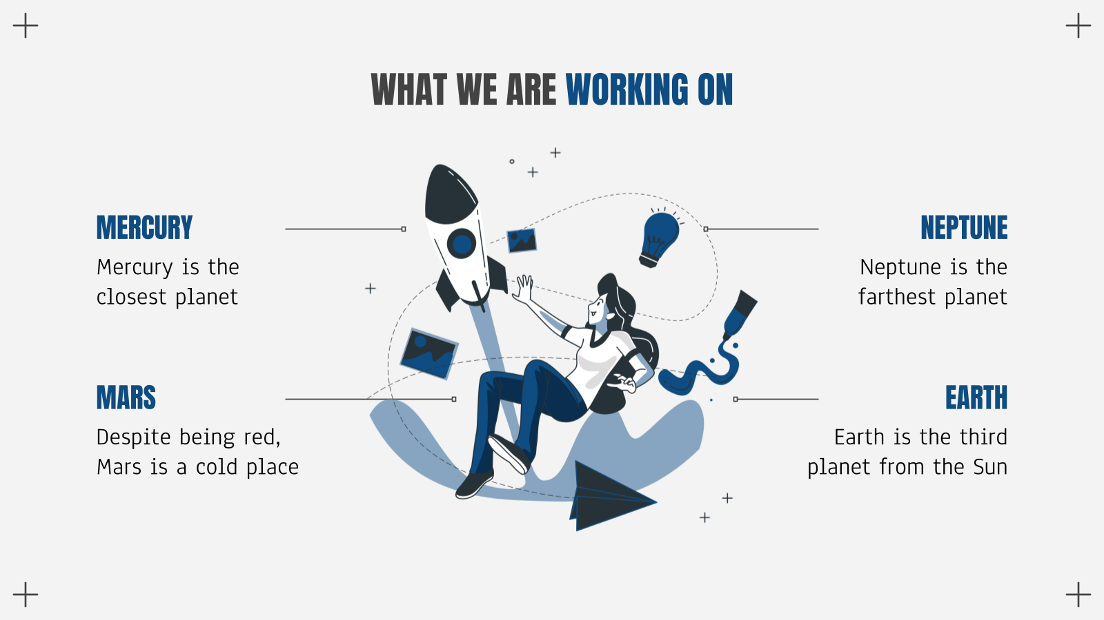
What We have Done
PRE-PROCESSING
CONVOLUTION
Converted to gray scale images and resize
Implemented
Convolution on
images
+
Max Pooling
Neural Network
Fetching sharp and smooth features
Performed Forward & Backward propagation

Slide 4
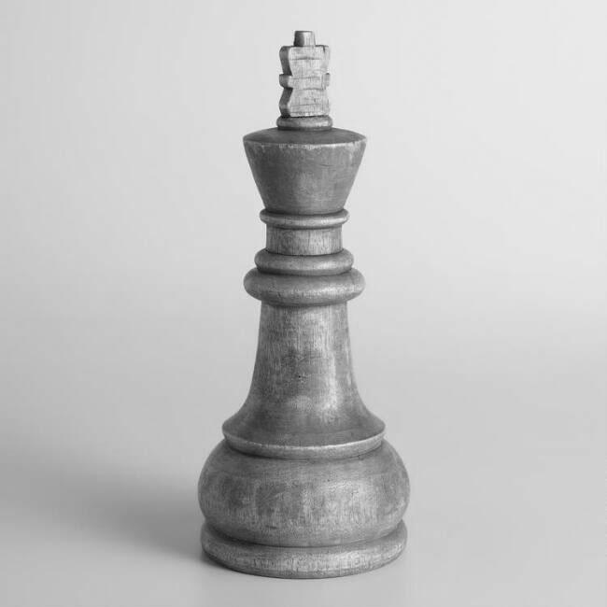
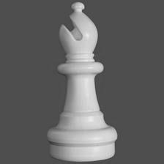
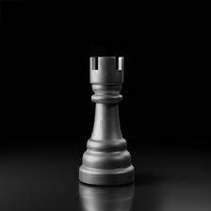
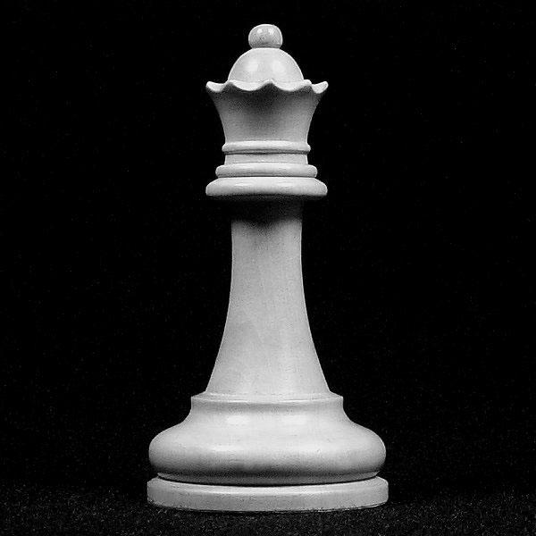
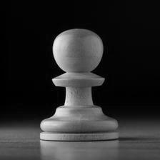
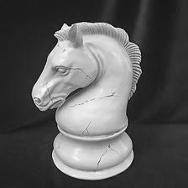
PRE PROCESSING
01
02
03
04
05
06

Slide 5

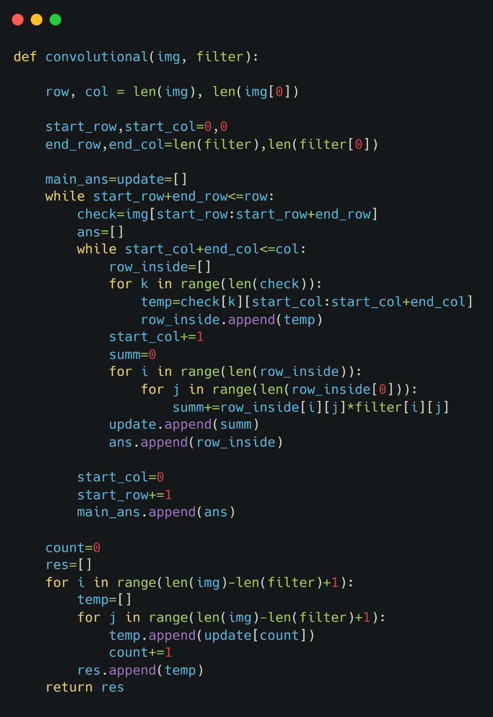
Applied Convolution on dataset using 26 different filters and selected 10 filters from it.
Total 120 images were used and after convolutional (applying 10 filters) we get 1200 different images.
Convolution

Slide 6
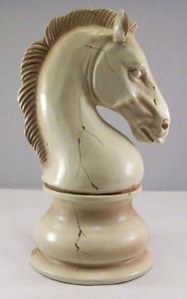
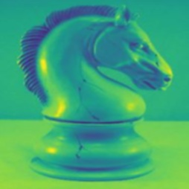
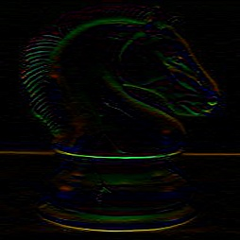
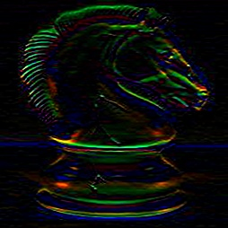
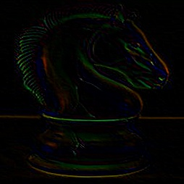
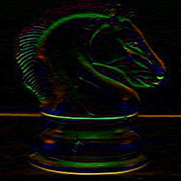
DIFFERENT FILTERS
Some of the filtered images after applying convolution
Original
Smoothing
Top Edge
Sobel - Top
Slant 1
Prewitt - top

Slide 7
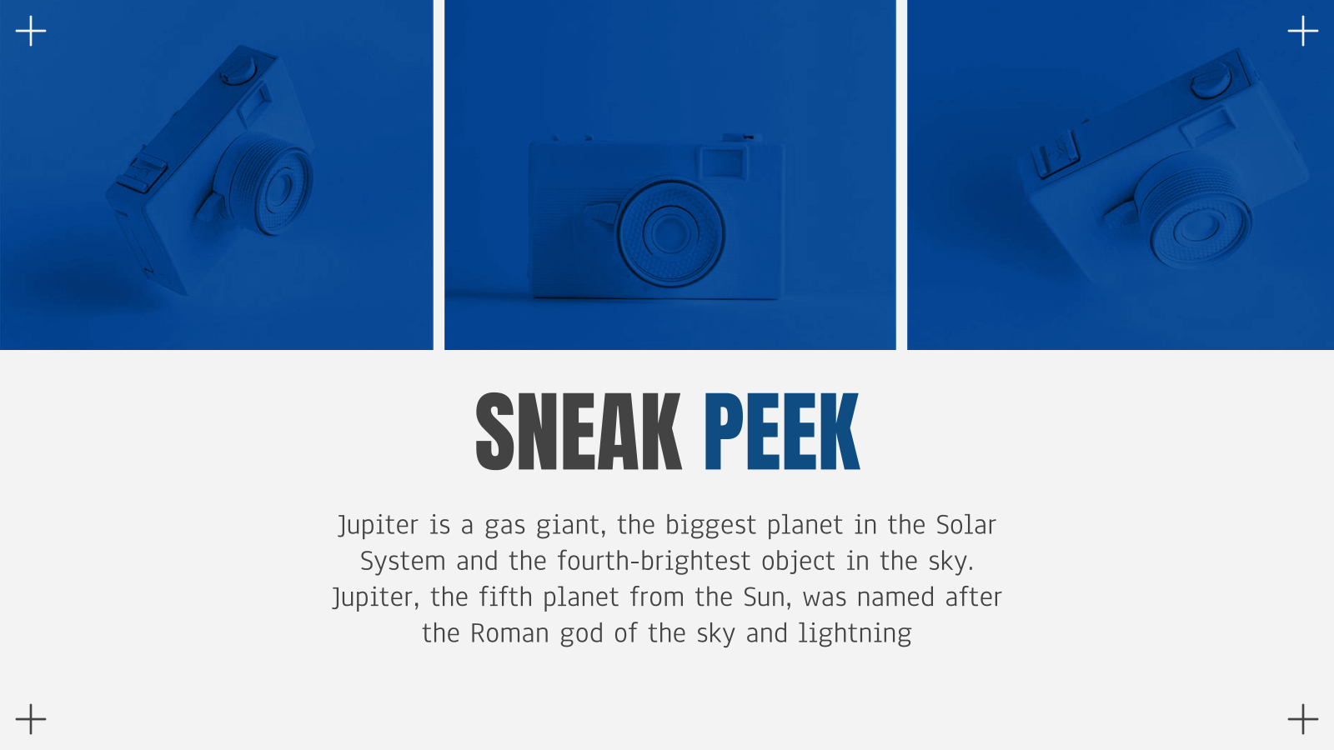
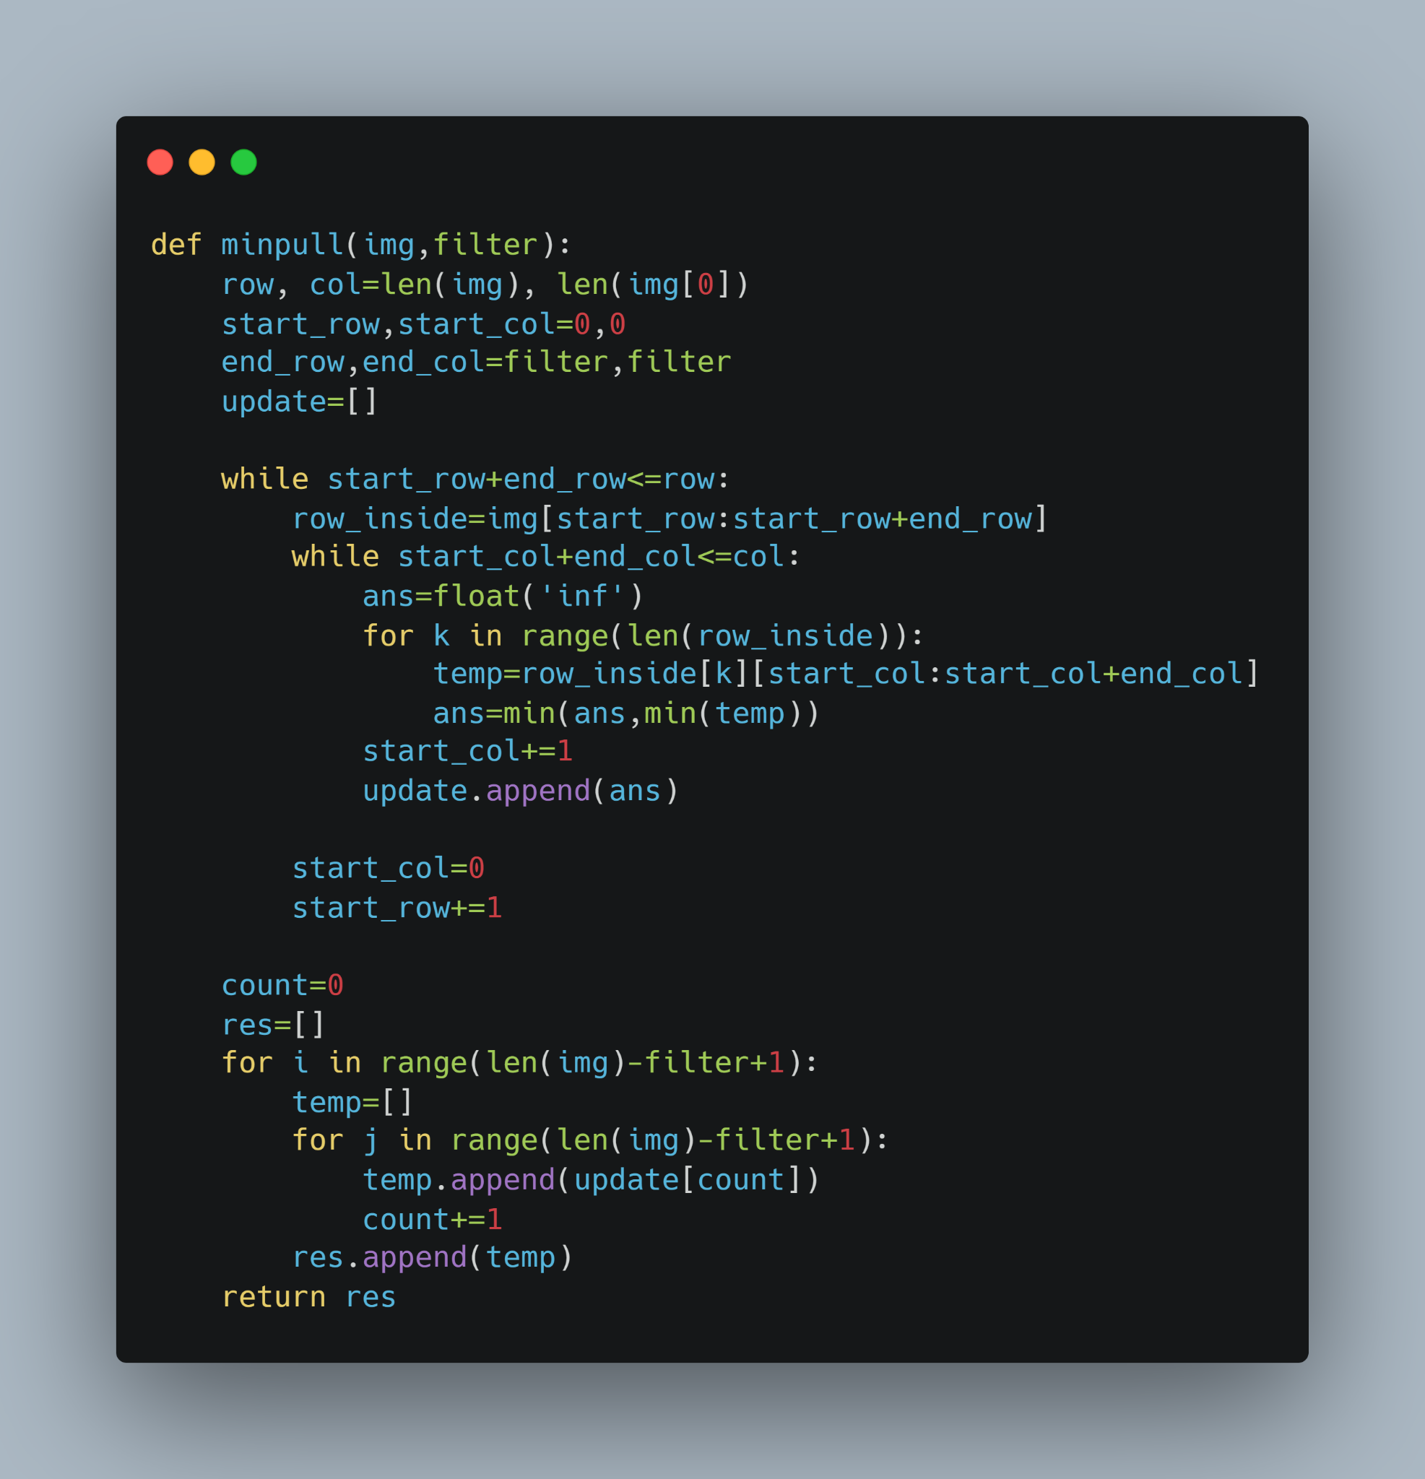
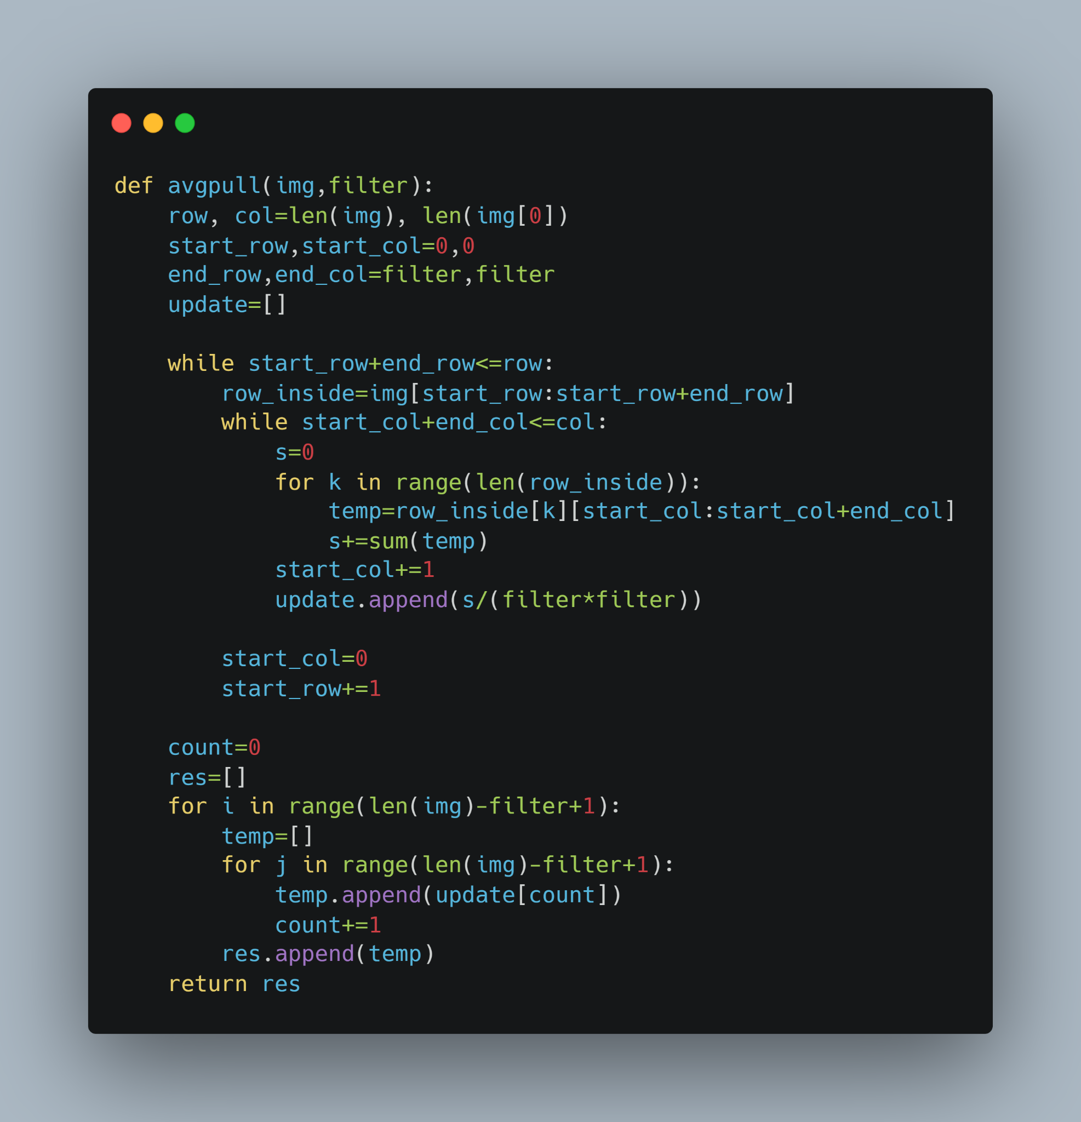
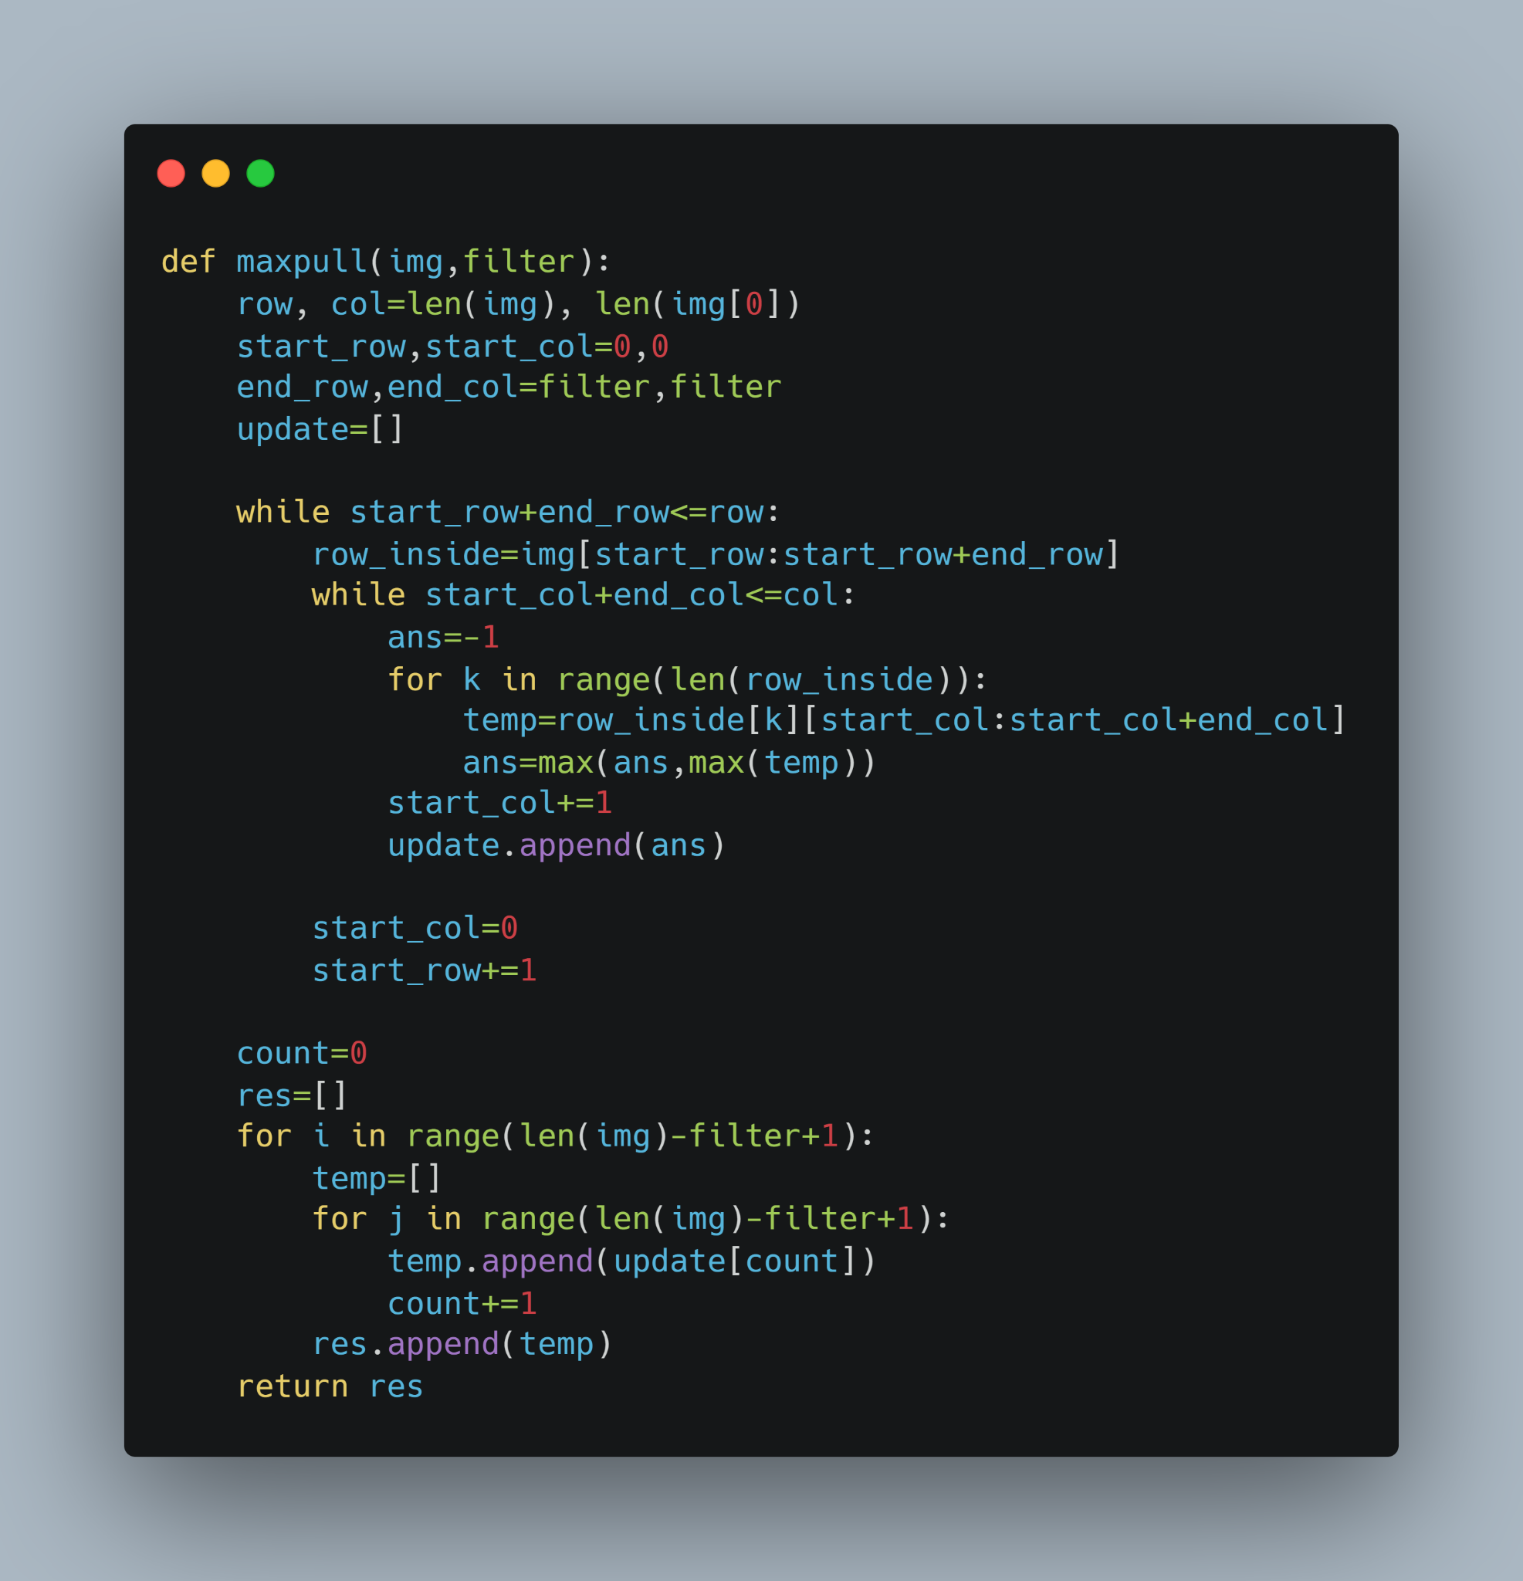
Minpool
Averagepool
Maxpool
DIFFERENT POOLING METHODS

Slide 8

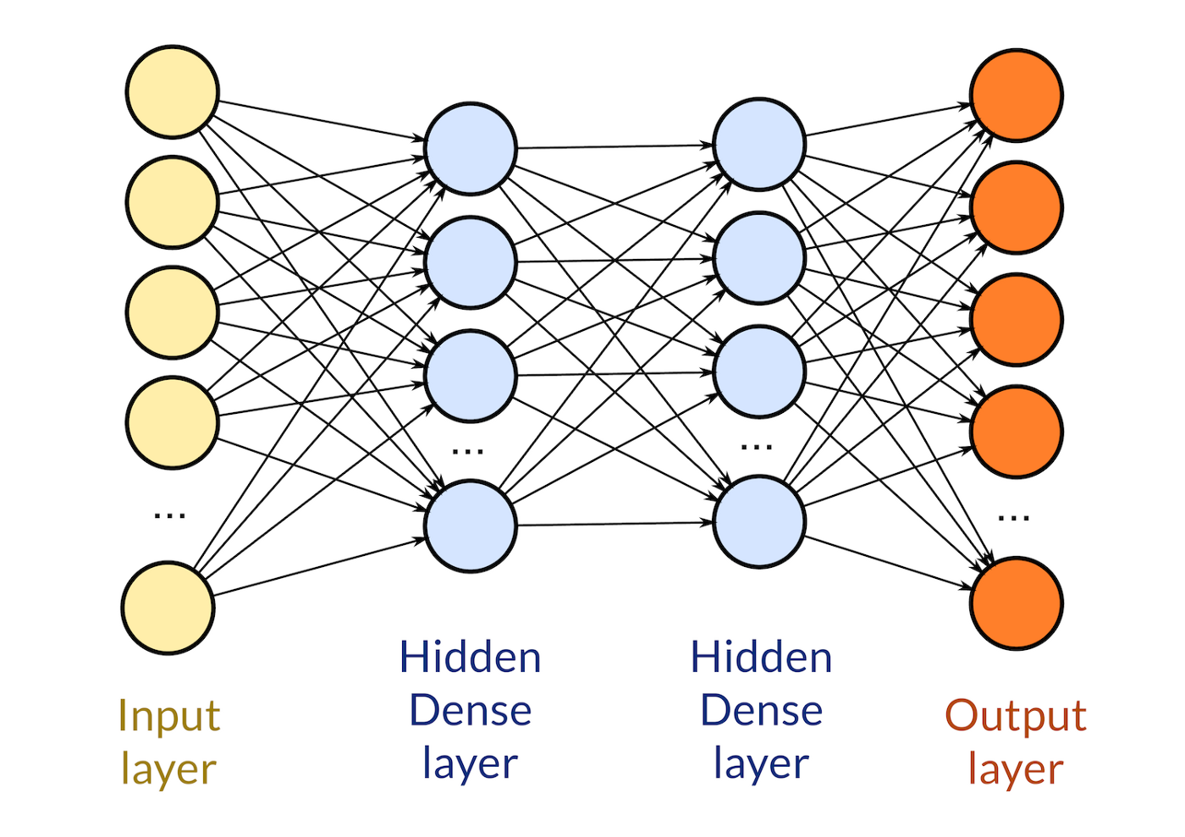

Flatten Layer
Flatten all its structures to create a single long feature vector to be used for classification.
The neurons of the layer are connected to every neuron of its preceding layer.
Dense Layer

Slide 9
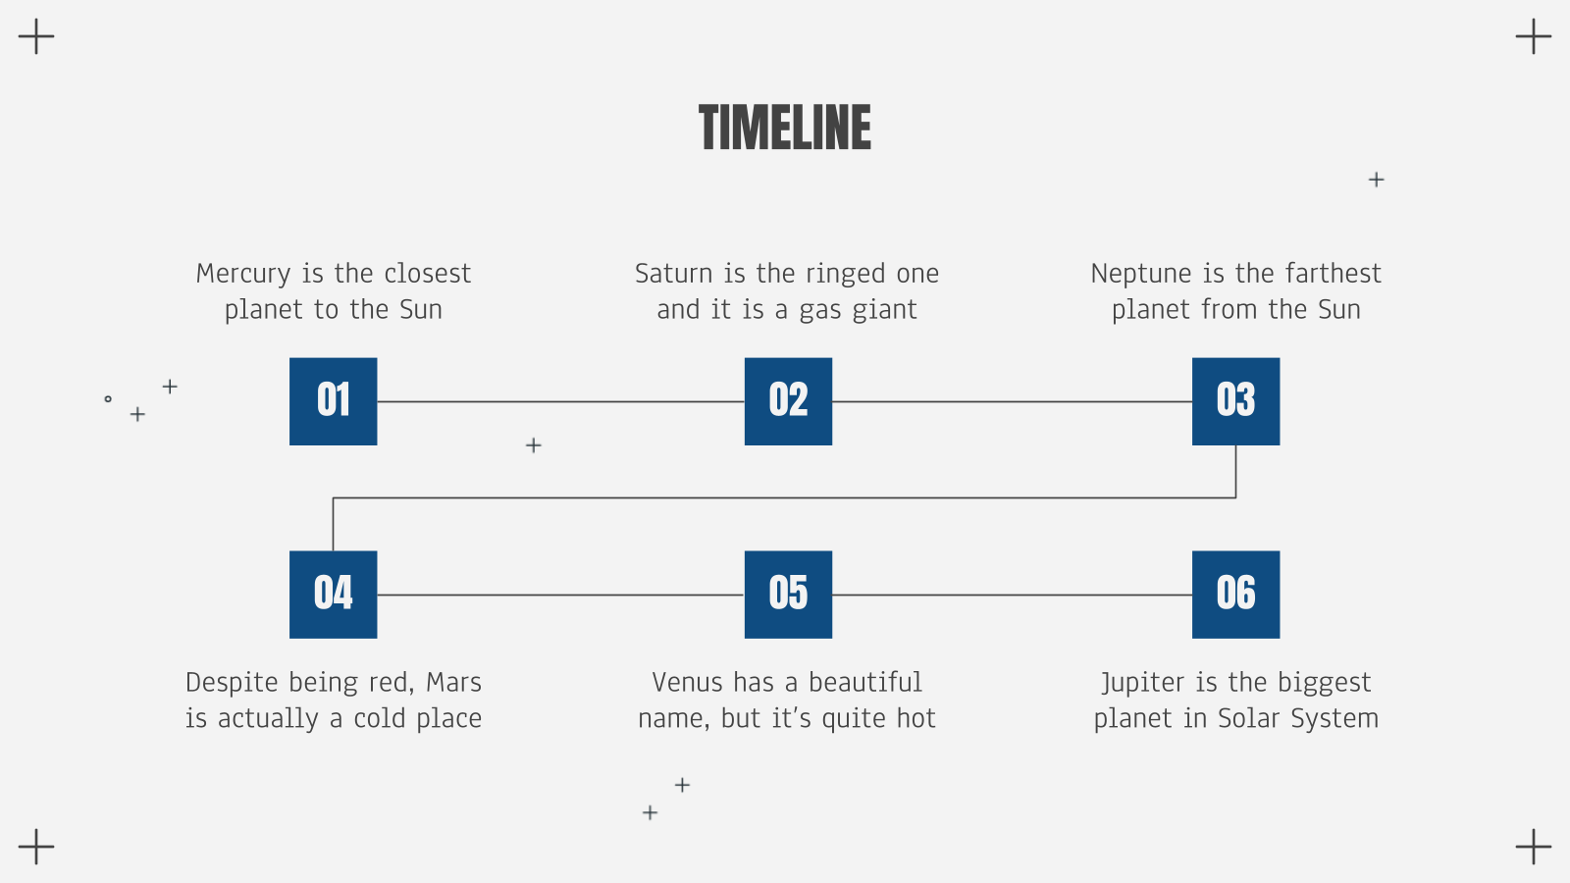
PROCESSES IN ONE ITERATION
Input of images
Forward Propagation
Activation Function
Output (Input for next iteration)
Output layer
Backward Propagation

Slide 10
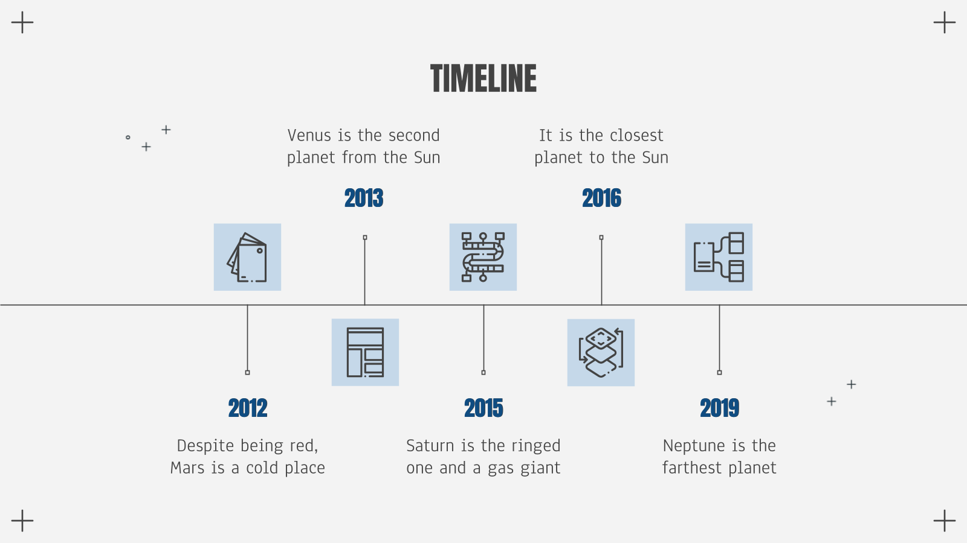
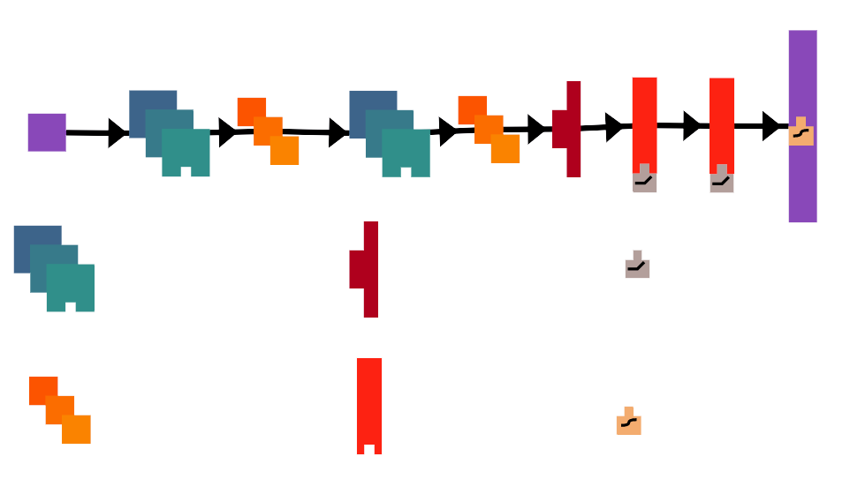
STRUCTURE OF THE CLASSIFIER
Convolution
Flatten
ReLU
Max Pooling
Dense
Sigmoid

Slide 11
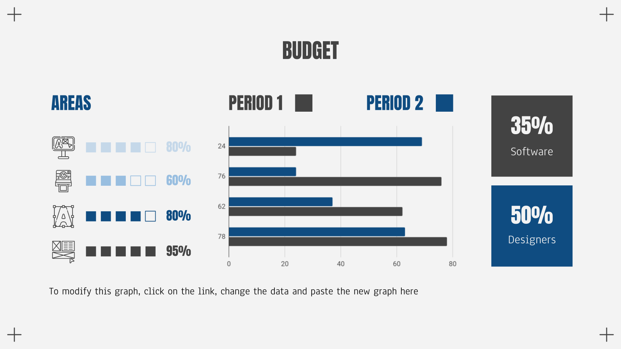
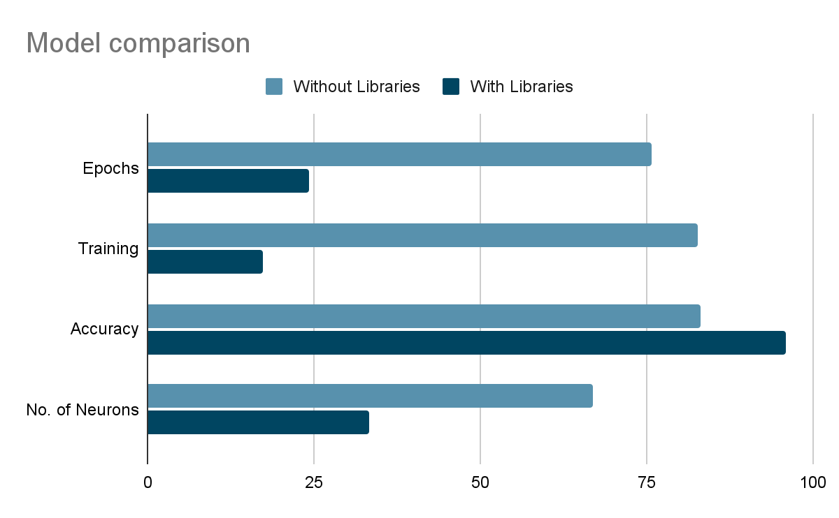
Model Comparison
Accuracy
83 %
Without Libraries
96 %
With Libraries

Slide 12
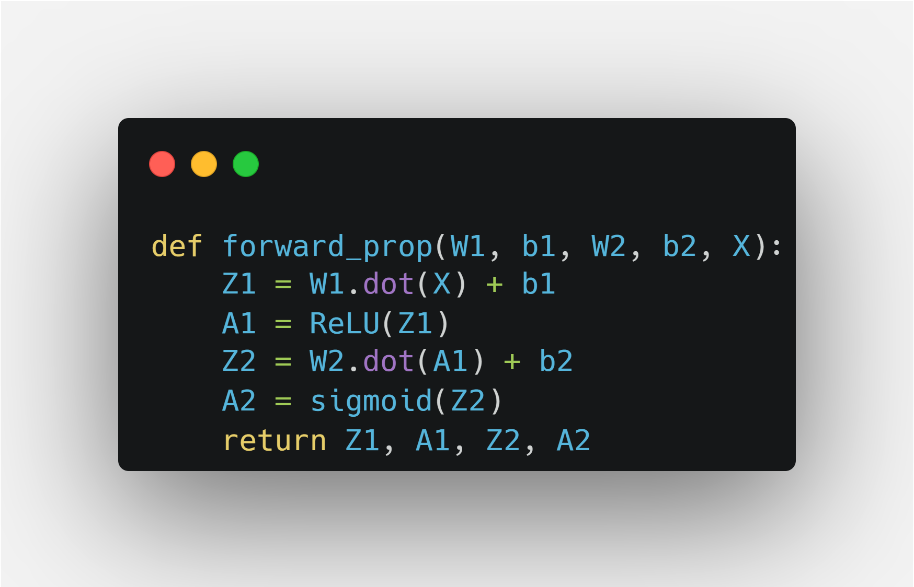
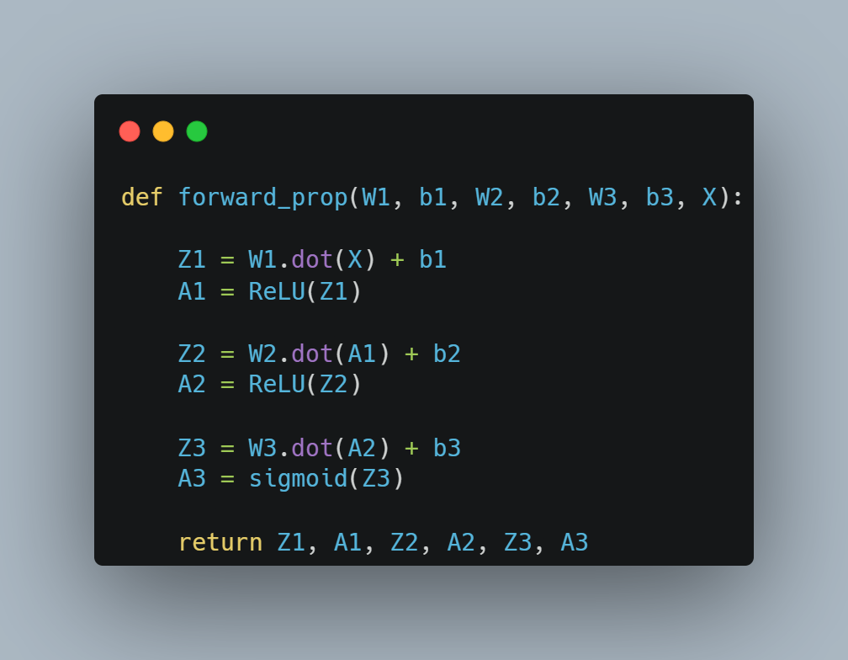
FORWARD PROPAGATION
FORWARD PROPAGATION
For 1 Hidden Layer
For 2 Hidden Layer

Slide 13
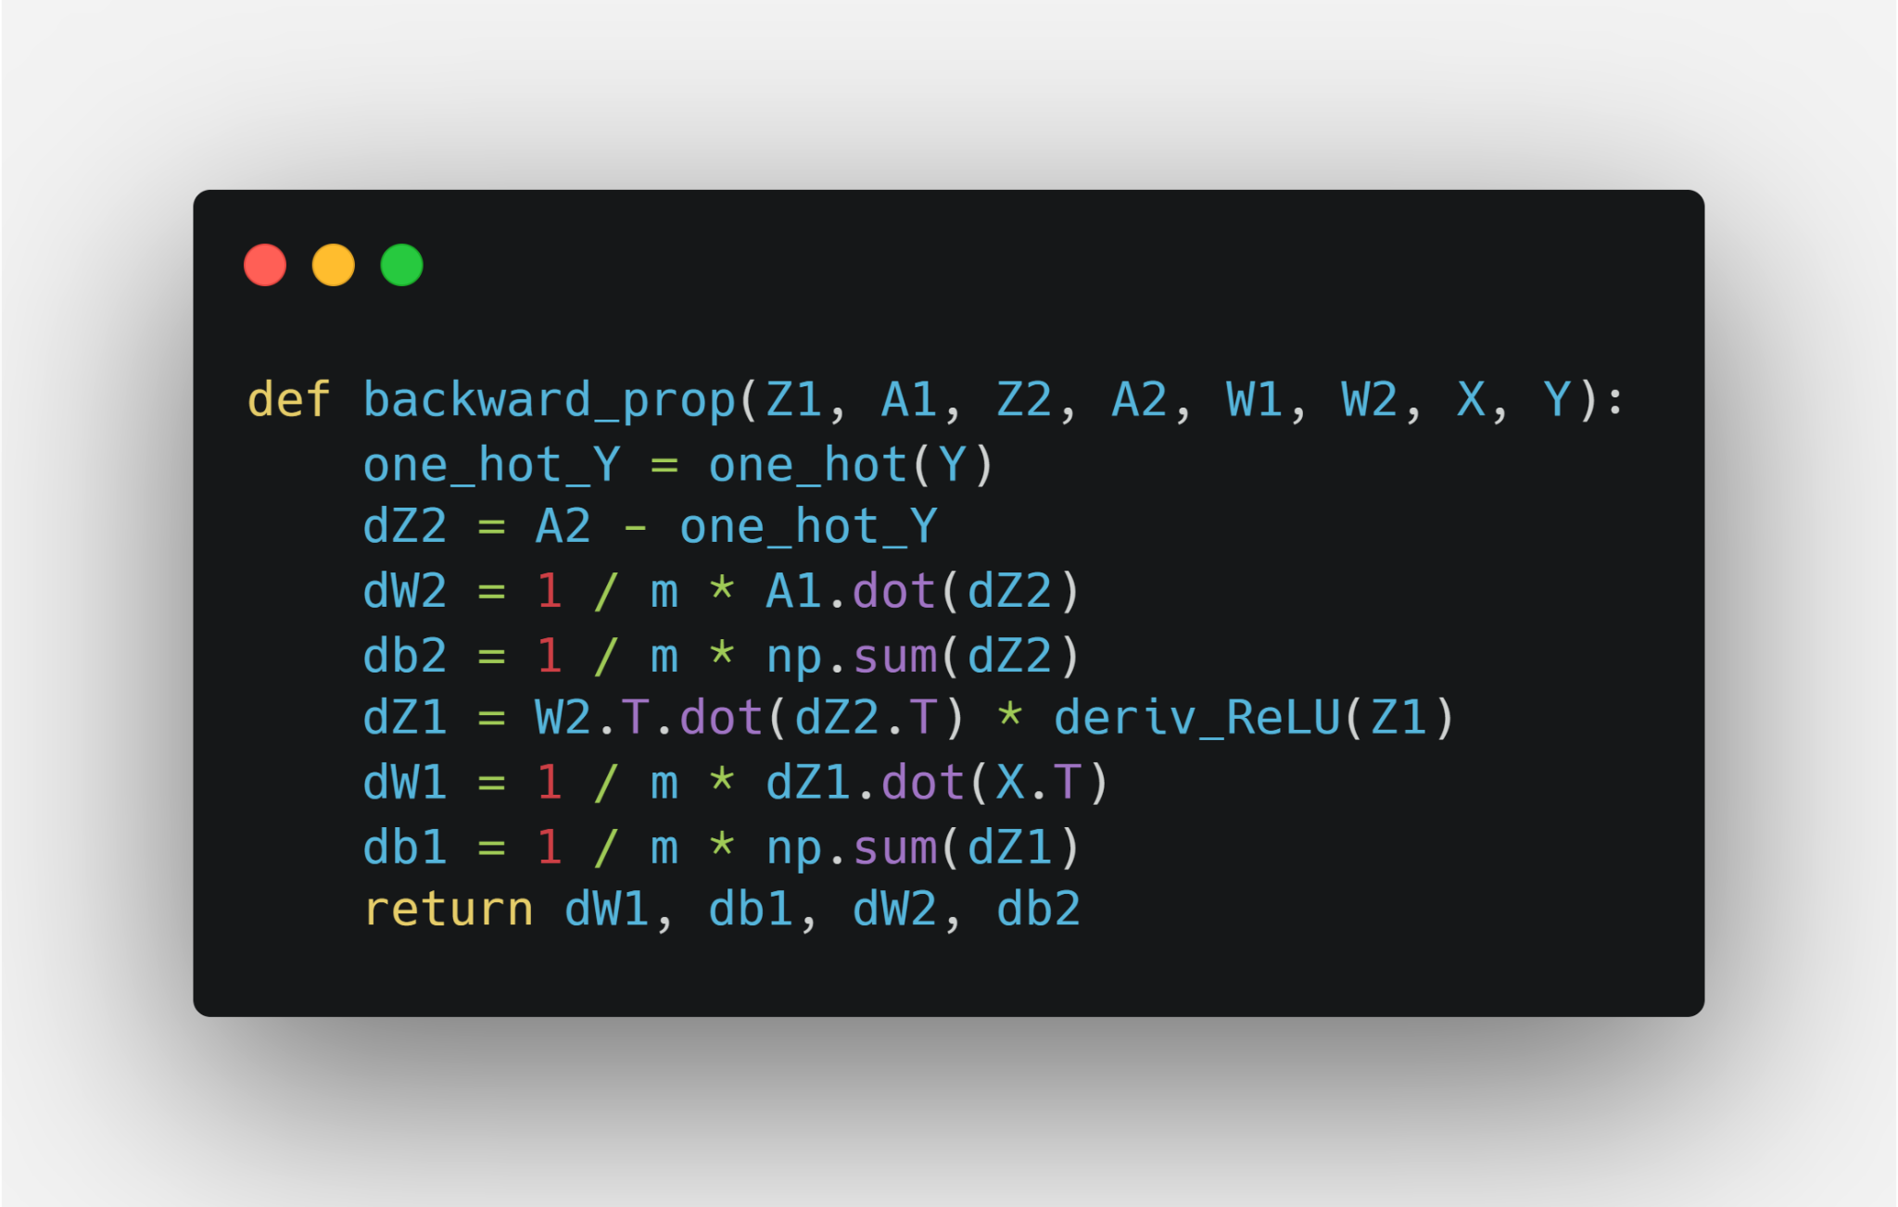
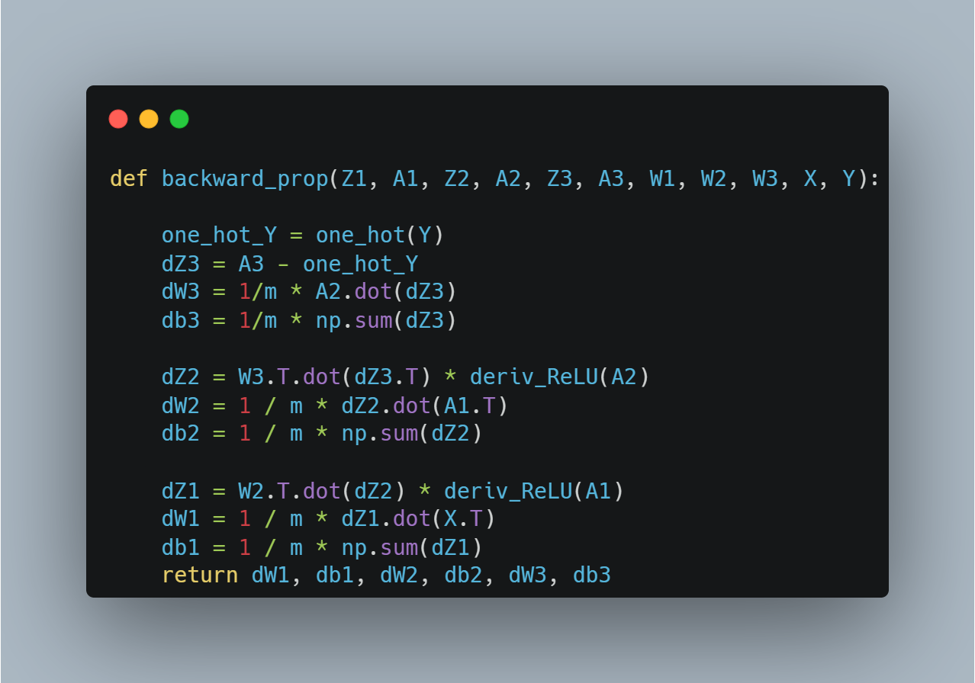
BACKWARD PROPAGATION
BACKWARD PROPAGATION
For 1 Hidden Layer
For 2 Hidden Layer

Slide 14
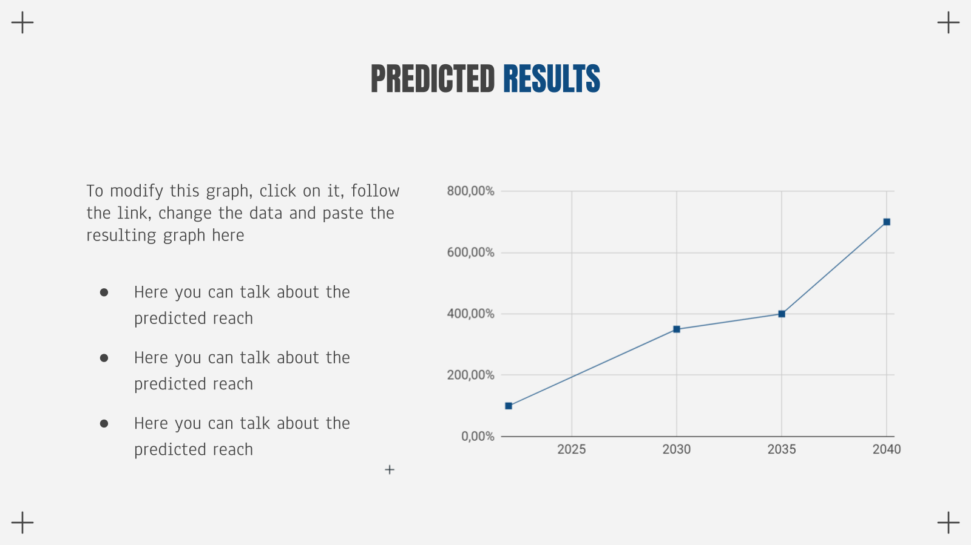
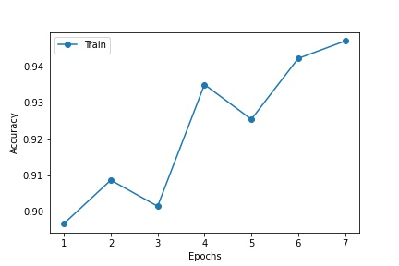
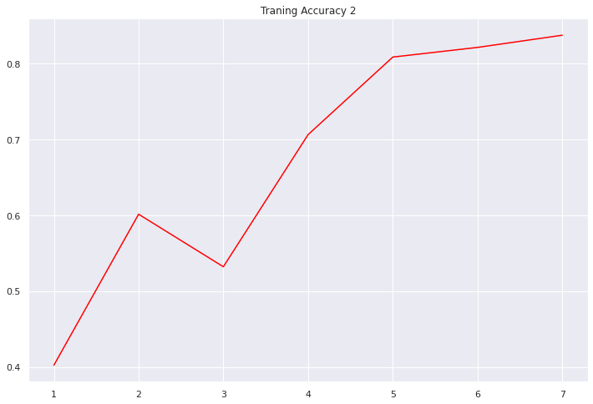
Successfully established the formation of a convolutional neural network layers for detecting multi class dataset of chess pieces.
Using above layers we have build our model and tested with images successfully.
We have successfully classified images with an training accuracy of 82% and validation accuracy of 67%.

Slide 15
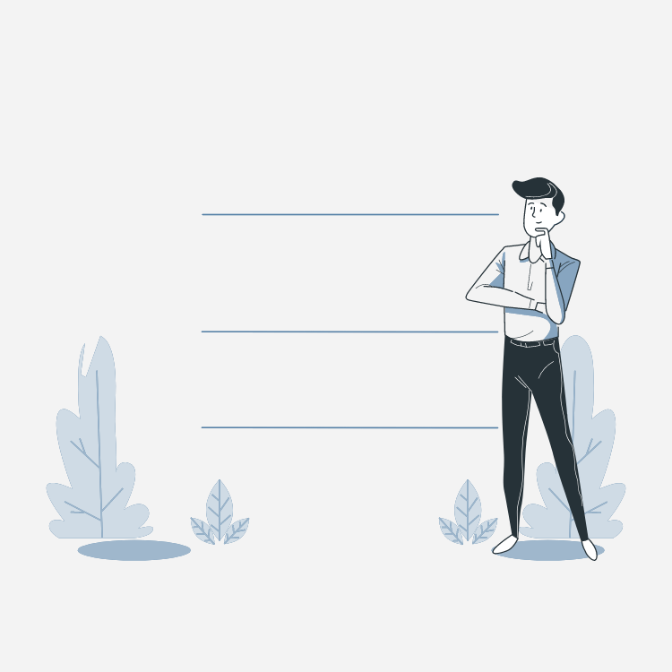
Conclusion
CNN is useful for detecting object with high accuracy.
As we have trained on both the models, we can conclude that the model which we have used with libraries have taken around 45 minutes. And with our model it has taken around 3h 35 minutes.
Hence using our model, we can adjust all the convolutional layers, neural network layers and activation functions.

Slide 16
REFERENCES
DATASET- https://www.kaggle.com/datasets/niteshfre/chessman-image-dataset
Preprocessing- https://drive.google.com/drive/folders/1OcQ3y-OrMtVVFPQcdg5Njf3gqNIu8Knk?usp=sharing
Conv + MaxPool- https://drive.google.com/drive/folders/1yvG2vfM65AX_yUMCByaZrUV0I7BcLqpb?usp=sharing
2nd Conv + MaxPool- https://drive.google.com/drive/folders/1pxfK8rMJBQcW0EJXN6EsBGEkkFR33mWc?usp=sharing
Code- https://colab.research.google.com/drive/1hWM2yt7vrs8GPys6nOK3yEvO_L_Y0-6M?usp=sharing
Model Visualizer- https://math.mit.edu/ennui/
Carbon Images- https://carbon.now.sh/

Slide 17
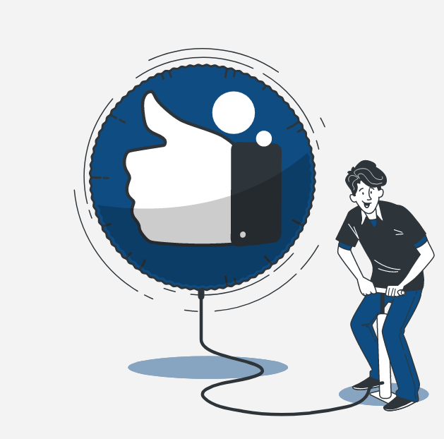
THANK YOU
Template Credit: Slidego, Flaticon, Freepik, Stories

